Slide 1


Leading in Complex Environments
DevOps Enterprise Summit
October 2020
David Silverman &
Jessica Reif
Notes:
Introduction from Gene

Slide 2
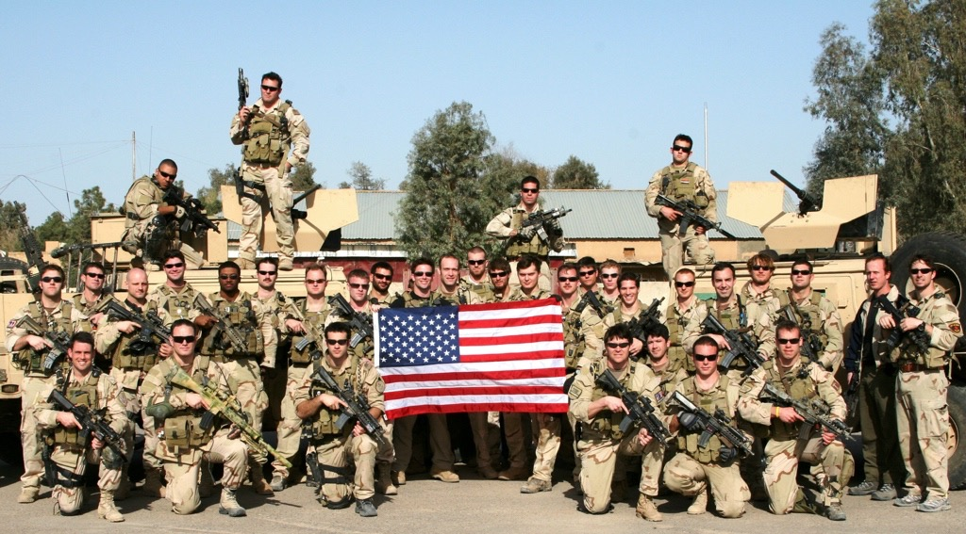
Notes:
Dave

Slide 3






US Counterterrorism
World Class
Successful
Tribal & Siloed
Notes:
Dave

Slide 4
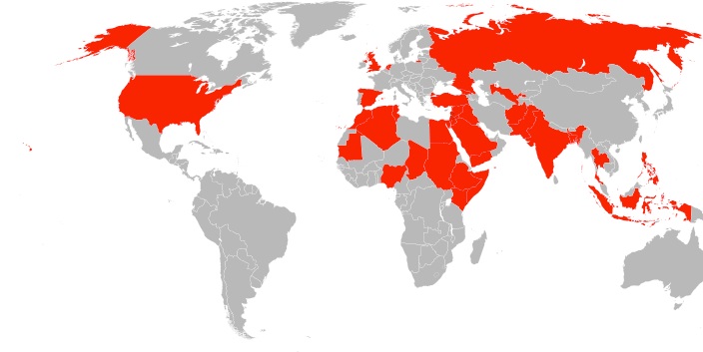
DIFFERENT
ENEMY
Notes:
Dave

Slide 5
How we looked…
…and how we assumed they looked.
Notes:
Dave

Slide 6
What they really were…
Notes:
Dave

Slide 7
Notes:
Dave

Slide 8
<
CONSISTENT
ADAPTABLE
Notes:
Dave

Slide 9
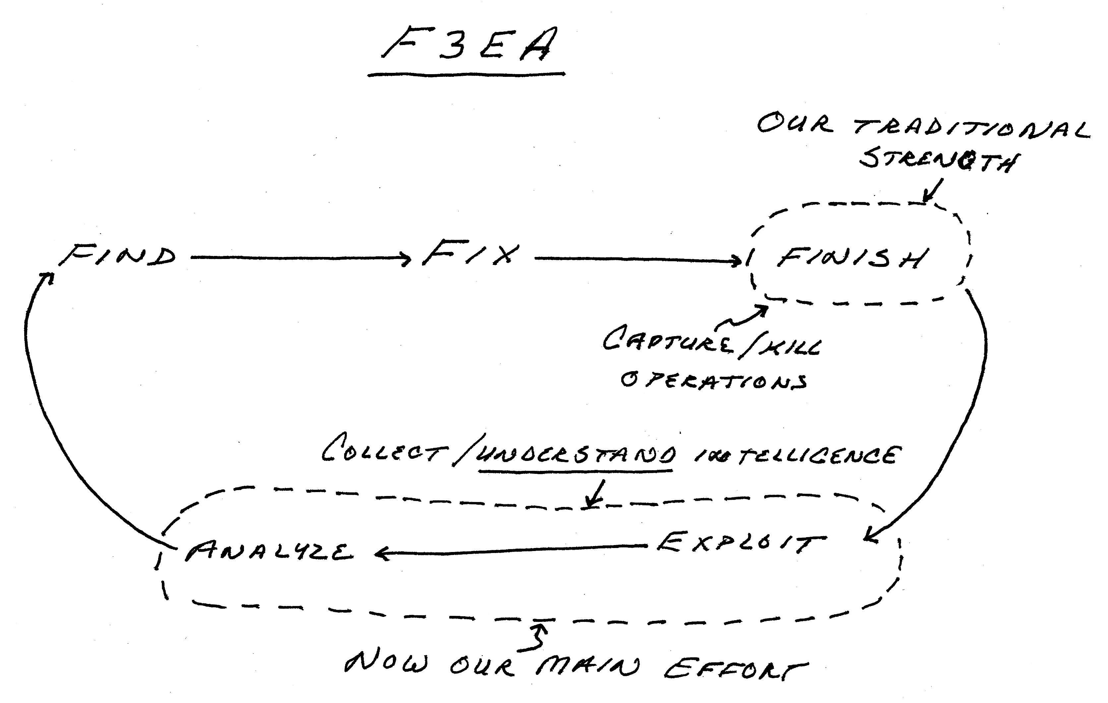
Counter Terrorism Operating Model
Blinks / Handoffs
Notes:
Dave

Slide 10
The Waterfall Model of Software Development
Requirements Gathering
Design
Build/Develop
QA/Test
Deliver
Three Problems with this Approach:
Handoffs between teams lead to information loss and coordination challenges
Feedback at any stage is highly disruptive
Deliverable is inconsistent with current customer/stakeholder requirements
Notes:
Jess

Slide 11

Emergent Approach: Agile Development
Cross-functional teaming
Iterative Planning and Execution Cycles
Minimum Viable Products – Test and Learn
Deliver Value Early and Often
Stakeholder Feedback
Notes:
Jess

Slide 12
Capabilities of an Agile Ecosystem
EMPOWERED
EXECUTION
TRUST
SHARED
CONSCIOUSNESS
COMMON
PURPOSE
Notes:
Jess and handoff to Dave

Slide 13
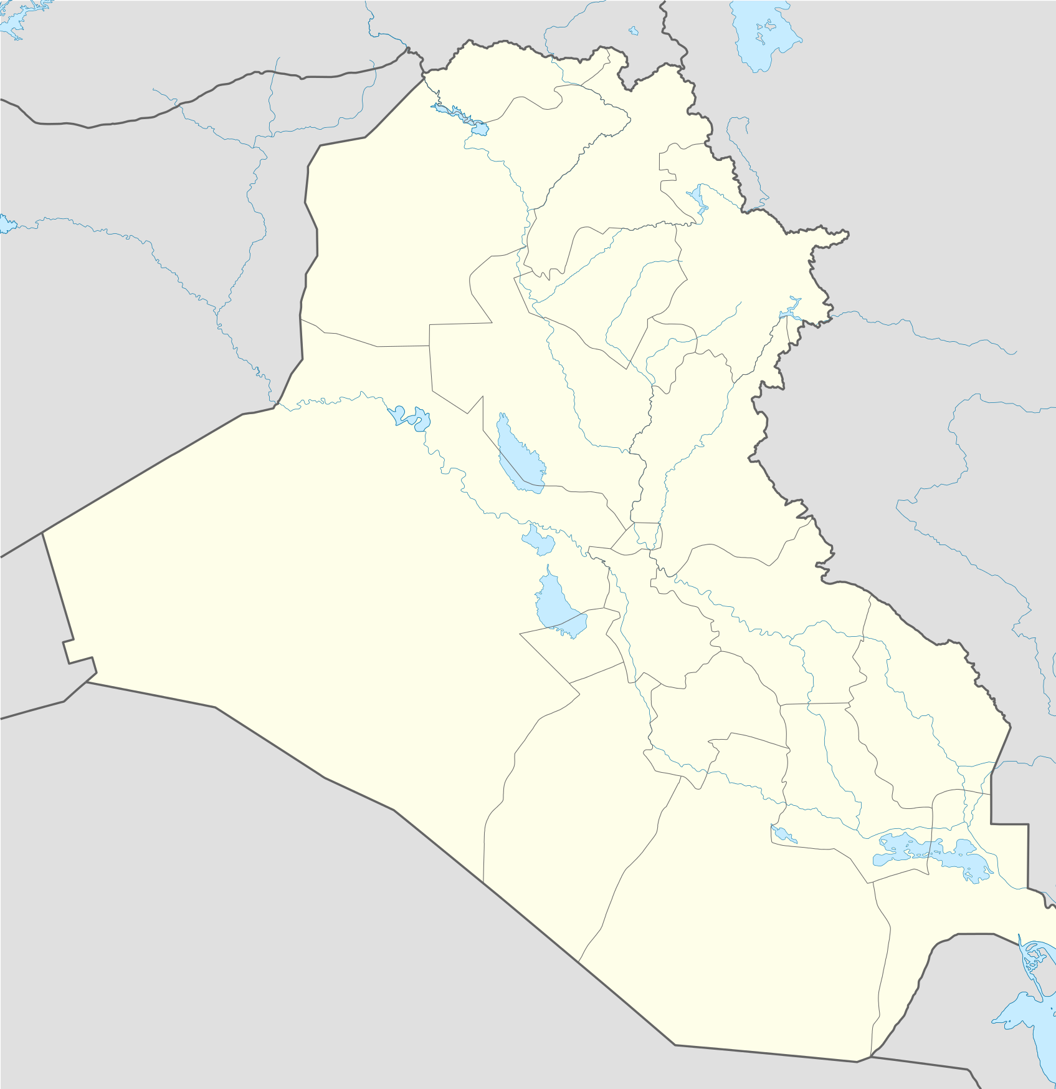



New Daily Operating Model
00:00
Special Operations Task Force Component Units: Iraq
OPERATIONS
Subordinate Task Force
Subordinate TF Coordination
F
E
A
F
F
Finish
Exploit
Analyze
Find
Fix
Mission
Planning
Subordinate Task Force
Headquarters
After
Action
Review
F
E
A
F
F
18:00
06:00
F
E
A
F
F
Asset
Allocation
Targeting
Meetings
Subordinate Task Force
F
E
A
F
F
O&I
Exploitation
O&I Prep
Portal
Upload
12:00
Notes:
Dave

Slide 14

Notes:
O&I meeting connected dots in real-time

Slide 16
Notes:
Went from hierarchy…

Slide 17
Notes:
To a network…

Slide 18
Ops Intel Update
1. Intelligence Update:
Results of Past 24 hrs
Upcoming 24 hrs
Overall Region Intelligence
Iraq
Afghanistan
Horn of Africa
2. Operations Update:
Summary of Past 24 hrs Opns & Upcoming 24 hrs
Iraq
Afghanistan
Horn of Africa
3. Liaison Team Updates:
CIA
CENTCOM
Joint Staff
4. CG’s Final Comments

Slide 19
What happened over the past 24 Hours?
What is the situation now?
What should we be doing differently?
How well is our network functioning?

Slide 20
Disciplined Daily Conversation Across the Command

Slide 21

Build & Maintain Contextual Understanding
in order to
Empower Decentralized Execution

Slide 22

The Liaison Network
Over 100 liaisons were hand-selected and deployed across the agencies
Notes:
Dave
Outcomes – working together
Unlike an API, need a human on the other side
141 liasions

Slide 23
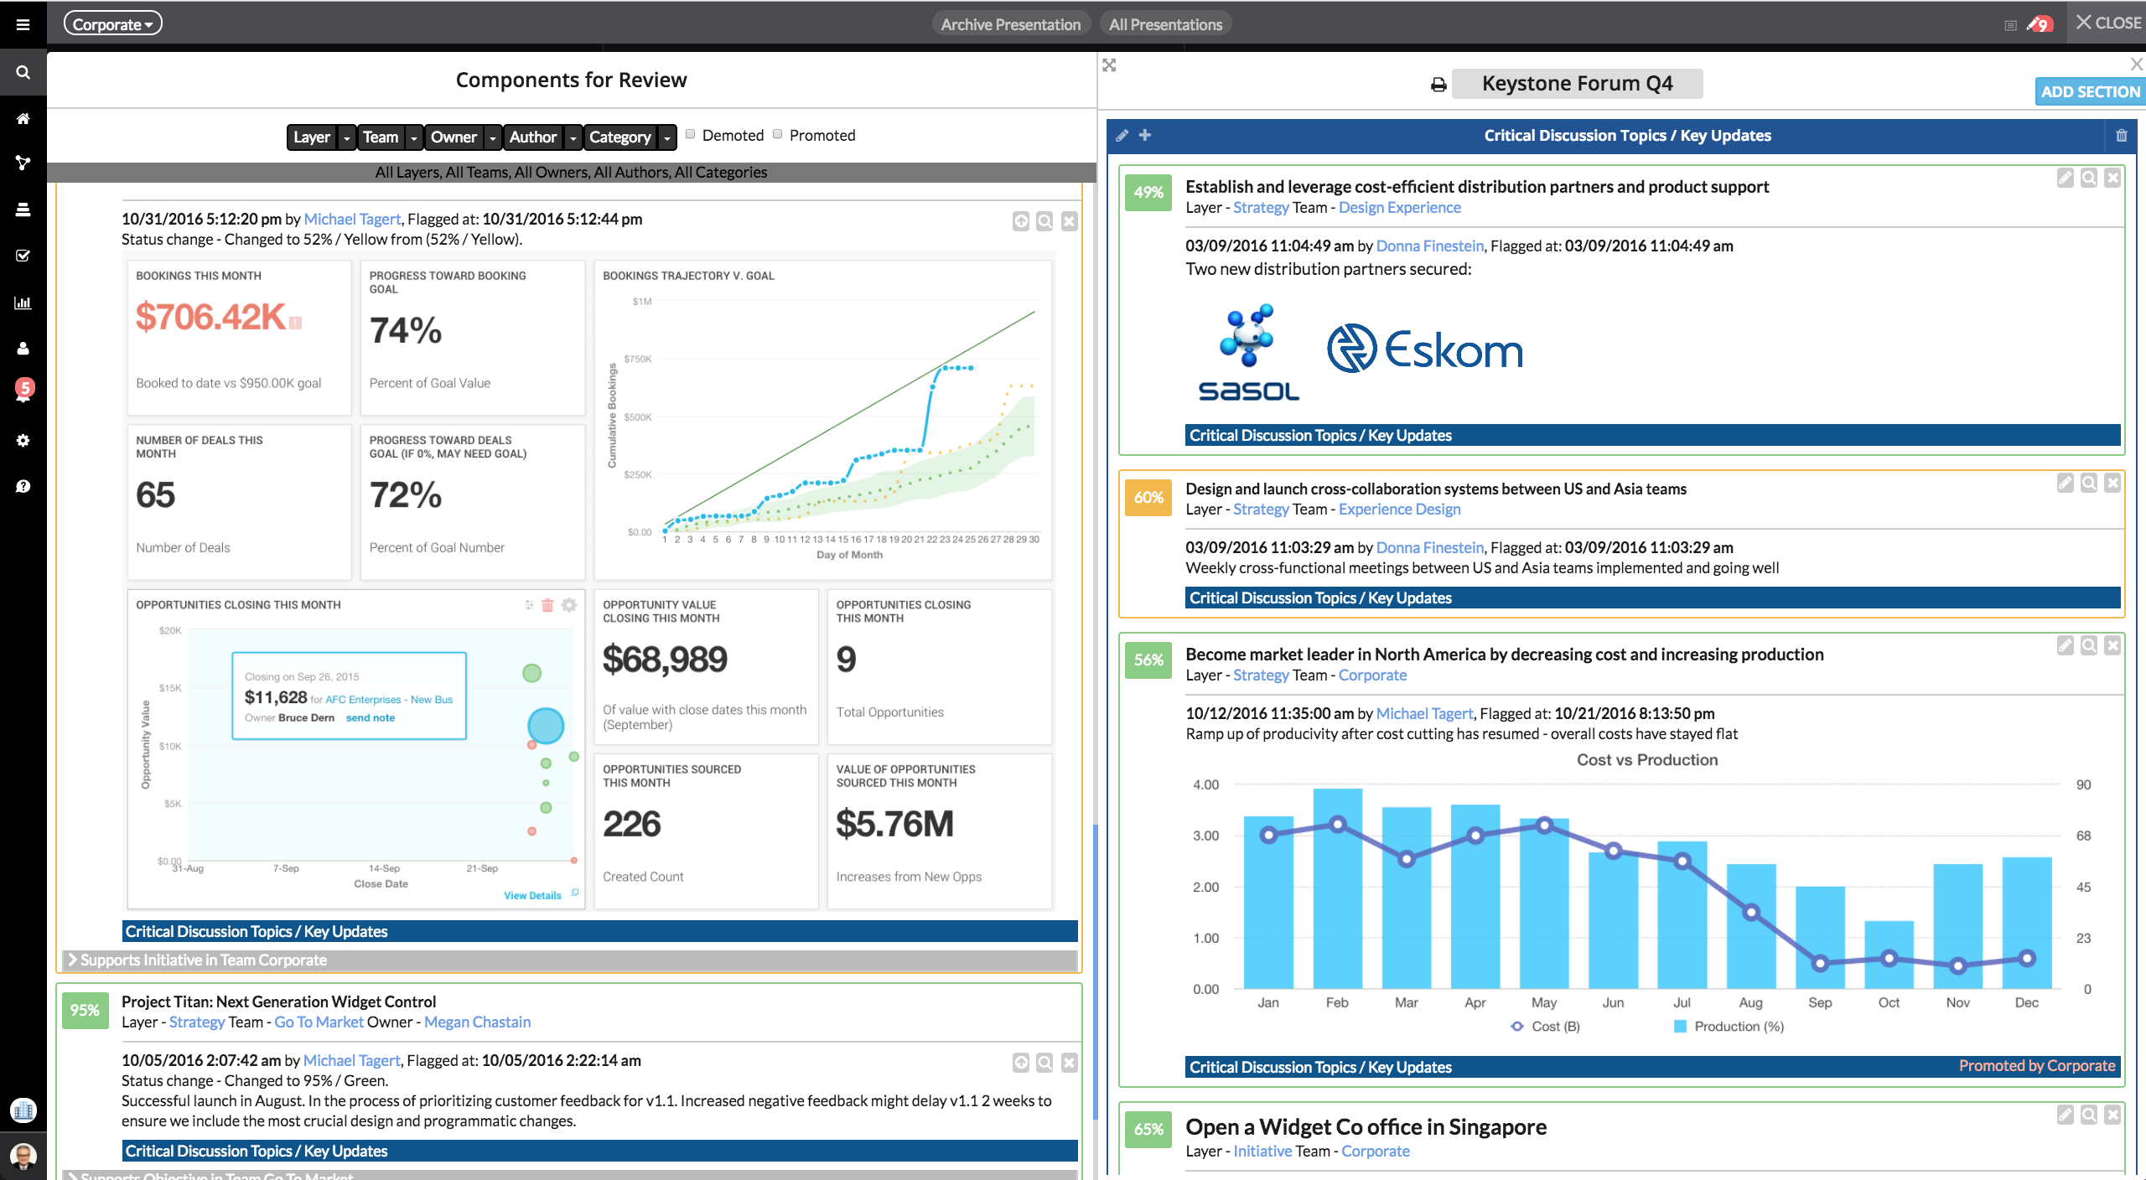
What is a Keystone Forum?
Transparency
& Accountability
What: 60-90 minute meeting on key interdependent initiatives.
Who: As many people as possible! Should grow organically
When: Variable (Weekly)
Why: Create Shared Consciousness to accelerate learning and accountability of execution
Learnings on Key Interdependencies
Notes:
Dave

Slide 24
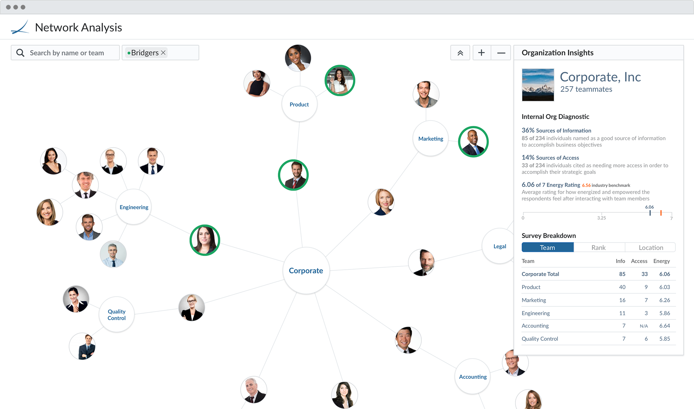
Measuring Keystone Forum Effectiveness
Signals of Effectiveness:
Creates dependency awareness
Grows organically
Leaders want to attend and fear missing out
Reduces the need for standing point-to-point meetings
Notes:
Jess

Slide 25

Notes:
Dave

Slide 26
Transformation from Different Vantage Points
C-Suite
Senior Management
Mid-Level Management
Individual Contributors
Good Idea Factory
Change = Risk
Show Me
Along for the Ride
Notes:
Maybe Jess?
(use 10-deploys a day example)

Slide 27
What does it mean to lead like a gardener?
Notes:
Jess

Slide 28
Execution in isolation creates risk. Leverage your forums and tools to create Shared Consciousness.
Guiding Principles:
Choose public channels over point-to-point channels
Shift from “need to know” to “expectation to share”
Think aloud to share your reasoning
Make dependencies explicit
Notes:
Dave or Jess

Slide 29


Focus on what you and only you can control.
Delegate until you’re uncomfortable
Look for opportunities to remove yourself from decisions
Notes:
Dave

Slide 30
Show your teammates that their contributions matter.
Transactional Leadership
Transformational Leadership
Translational Leadership
Guidance on daily assignments
Offer a compelling vision
Show how the daily work connects to the vision
Notes:
Jess

Slide 31

Be a leader in space exploration.
Put a
man on the moon.
vs
Notes:
Jess

Slide 32


Empower resource sharing.
Fund outcomes, not projects.
Encourage dynamic resource allocation.
Notes:
Dave, Jess
Examples of horse-trading:
Embedding best person with Delta Force, to get access to their ISR platform, horse-trading
(which reminds me of my favorite part of book: the officer taking out trash, getting Chick-Fil-A sandwiches. :)
- your ability to unlock incredible capacity on ISR
How it unlocked awesome outcomes — story of general asking, ”You have stuff on my equipment?”
Jess: how you’ve seen this done in software

Slide 33
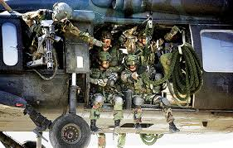
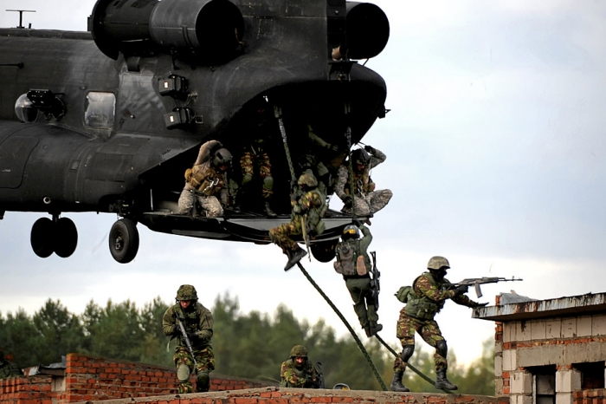
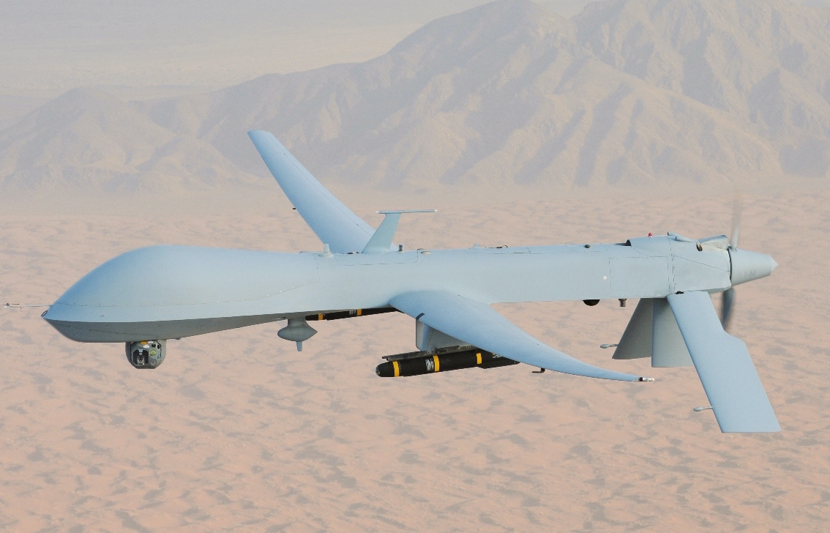
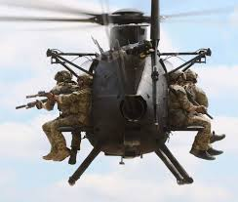
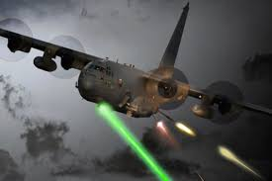
Resource Planning for High-demand, low-density assets

Slide 34
Your mandate is not perfection, but continuous never-ending improvement.
Notes:
Dave

Slide 35
Resources:
Join our recently-launched LinkedIn Community:
Search “CrossLead Community” and select “request to join”
OR follow this link: https://www.linkedin.com/groups/8954386
Check out our flagship leadership development course, the Multi-Team Leader Program, which launches this month! If you are interested in attending, email us at Jessica.Reif@crosslead.com for more information. We will offer a discount to DOES attendees and their teams!
Notes:
Jess

Slide 36
Help we’re looking for:
If you’re having success with Agile & DevOps in pockets, but hit a dead end because leaders are stuck in old ways of working, we want to solve that problem. We are writing a book on this topic.
If you have a situation where your leadership hasn’t had the “aha” moment, we’d love to help you crack that code.
Please email us at contact@crosslead.com
Notes:
Jess
If you're having successes at Agile and DevOps in pockets, but are hitting a dead end because of - but leaders are stuck in the old world, limiting the ability for this new way of working to succeed. - We want to solve that problem. In fact, we're writing a book on this. - So if you have a situation where your leadreship haven't had that aha moment, maybe even with a copy of Team of Teams on their bookshelf, we'd love to talk and help you crack that code. - Email us here.

Slide 37
Notes:
Examples of horse-trading:
Embedding best person with Delta Force, to get access to their ISR platform, horse-trading
(which reminds me of my favorite part of book: the officer taking out trash, getting Chick-Fil-A sandwiches. :)
- your ability to unlock incredible capacity on ISR
How it unlocked awesome outcomes — story of general asking, ”You have stuff on my equipment?”
Jess: how you’ve seen this done in software

